Slide 1

Green University of Bangladesh
Department of Computer Science and Engineering (CSE)
Faculty of Sciences and Engineering
Semester: Spring, Year: 2022, B.Sc. in CSE (DAY)
LAB REPORT NO # 05
Course Title: Structured Programming Lab
Course Code: CSE 104 Section: CSE 213 - DB (PC)
Lab Experiment Name(s):
Lab Report of Problem-Solving Using Loops in C
Student Details
Name | ID
Md. Shahidul Islam Prodhan | 213902017
Lab Date: 05 March 2022
Submission Date: 12 March 2022
Course Teacher’s Name: Md. Solaiman Mia, Assistant Professor.
[For Teacher’s use only: Don’t write anything inside this box]
Lab Report Status
Marks: | Signature:
Comments: | Date:

Slide 2
1. TITLE OF THE LAB EXPERIMENT
Lab Report of Problem-Solving Using Loops in C
2. OBJECTIVES
Doing this experiment we will learn about loops in the C language and we will be able to solve complex problem using loops.
3. PROCEDURE
Problem 1: Check if number is prime or not from existing algorithm.
First we declare the necessary variables in int function and take input from the user a valid integer by using printf and scanf function. We use mod to check if the remainder is 2 or 0. If the count is 2 it is a prime number otherwise it is not a prime number.
Problem 2: All Fibonacci numbers bellow n
First we declare necessary variables and take valid input from the user. We take user input for necessary nth terms. The logic of Fibonacci is – the 3rd number will be the addition of 1st and 2nd number the loop will going on until the number is equal or less than nth terms.
Problem 3: Pascal’s triangle until given row.
At first, we declare necessary variables and take valid user input. We use for loop in. Then we use nested loop to solve this problem.

Slide 3
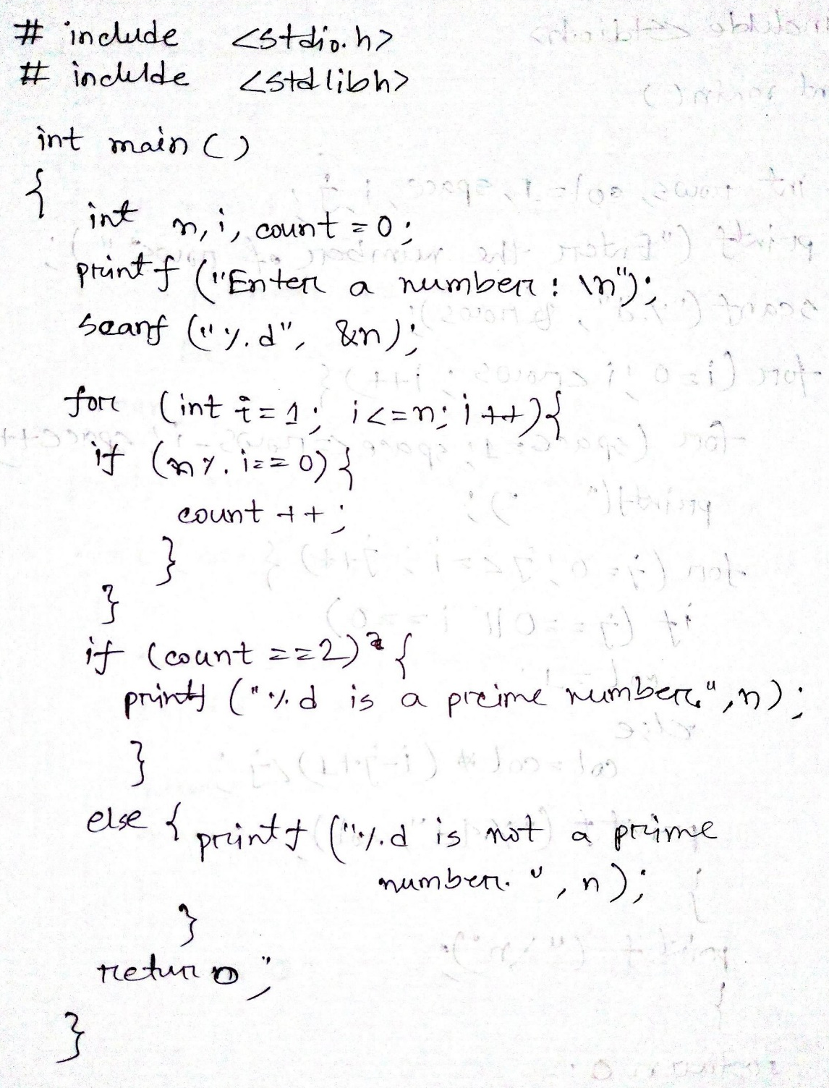
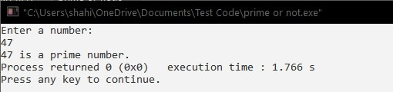
4. IMPLEMENTATION & TEST RESULT
Problem 1: Check if number is prime or not from existing algorithm.

Slide 4
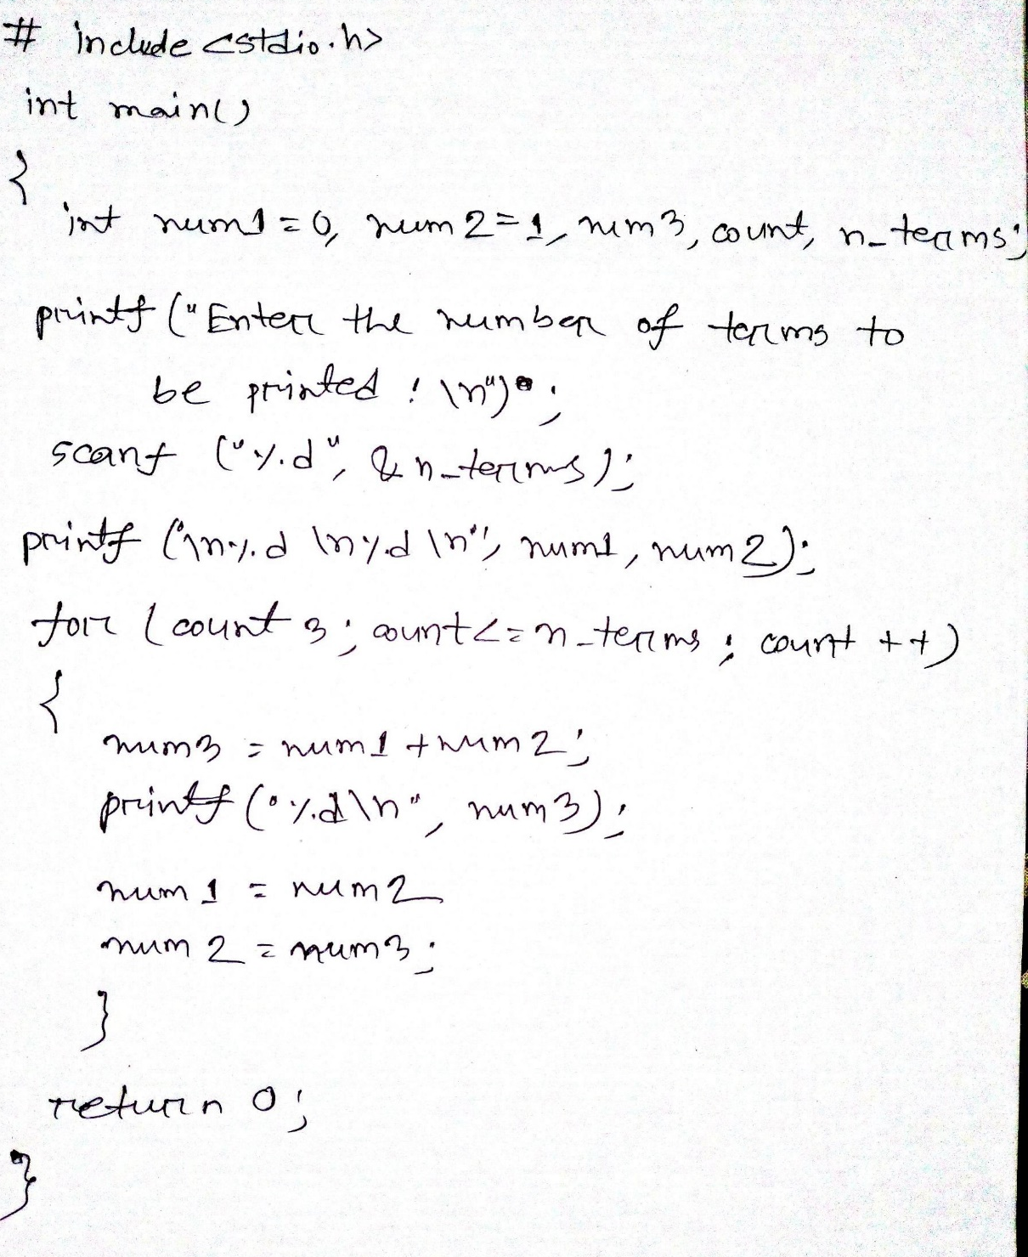
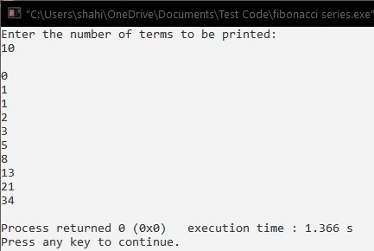
Problem 2: All Fibonacci numbers bellow n

Slide 5
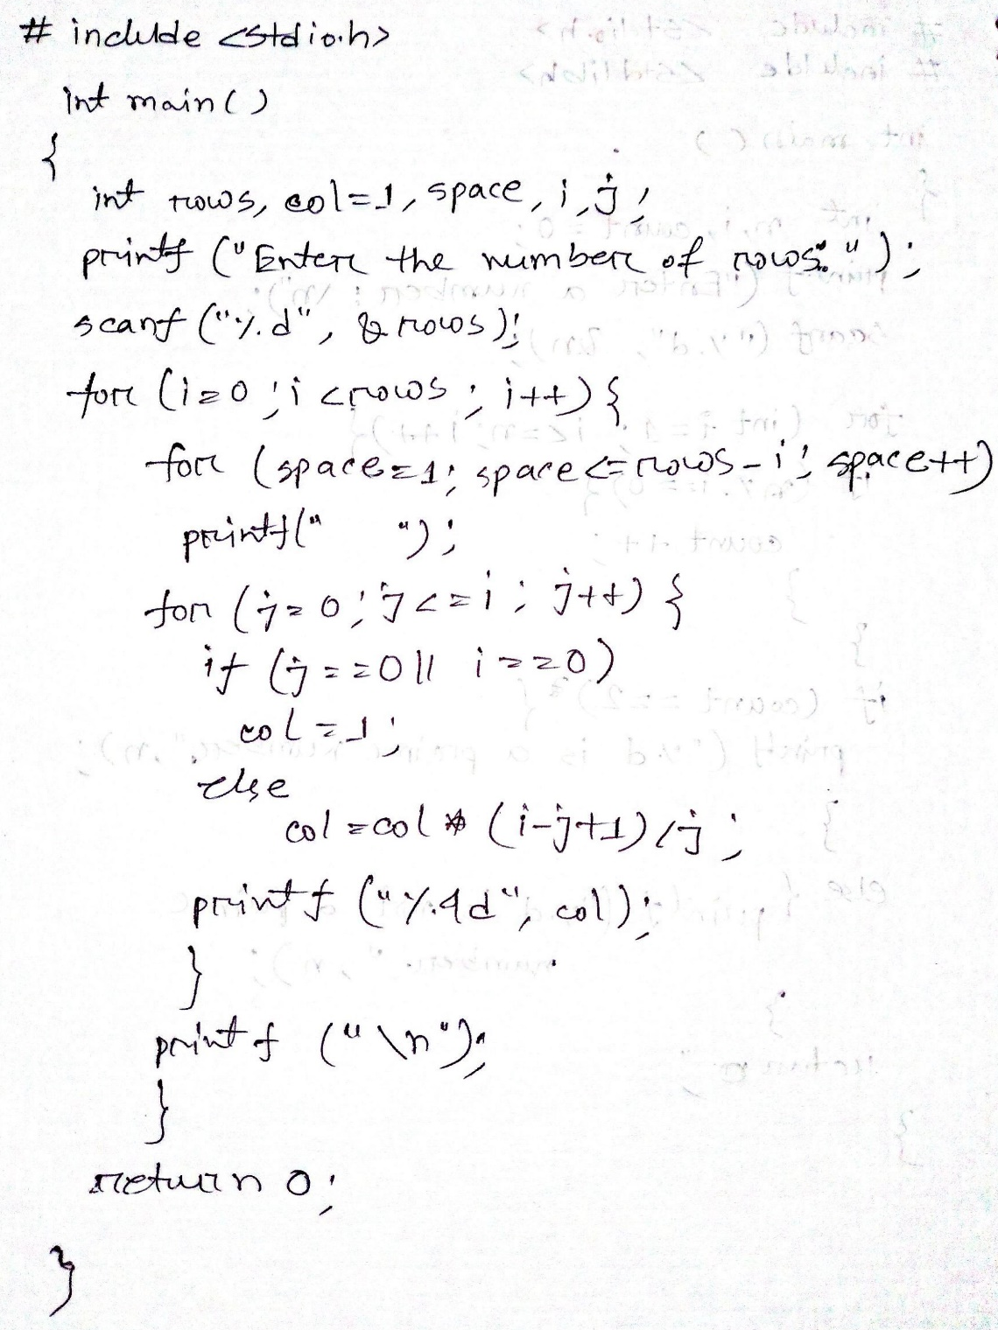
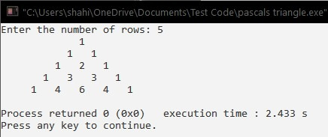
Problem 3: Pascal’s triangle until given row.

Slide 6
6. ANALYSIS AND DISCUSSION
We have solved those problems using CodeBlocks IDE and there were no errors occurred. And we can successfully print the output of those problems.
We have faced a little bit difficulty while performing pascals problem showing the wrong results but then we have passed errors and corrected our program and it gives correct result.
Solving these 3 problems, we have initially learned some of the advanced level of complex problems in C language using different loops.
7. SUMMARY
From the given experiments, we have learned the use of different loops in various complex problems and their usage varies from problem to problem and how to use some advance complex problems using loops.

